Slide 1

Ruben Arutyunov, Sarvani Dasari, Jamie Friedt
and Price Ketterling

Slide 2

About Capturis
A NISC Company that provides multi-site businesses with a utility information management service.
Services offered:
Utility bill payment administration
Utility information services
Utility consumption
Cost Tracking

Slide 3
Introduction
Capturis
Wendi Bates – Customer Account Representative(Sponsor)
David Aichele- Software Director(Co-Sponsor)
Royce Havelka – Senior Software Developer (Technical Mentor)

Slide 4

Problem
Capturis relies upon third party vendors to test data entry applicants
Relying on these vendors to evaluate each candidate is costly, especially when considering the number of candidates that are tested in relation to the number selected for employment.
Additionally, these vendors often times expire the test results, requiring additional tests if the candidate applies in the future.

Slide 5

Solution
Create a web based tool that utilizes the 10 Key Pad.
10 Key Speed is measured in Keystrokes Per Hour (KPH). KPH defines how many keys one can hit per hour.
Accuracy is just as important as speed, so the assessment tool will also monitor how many errors an individual makes.

Slide 6
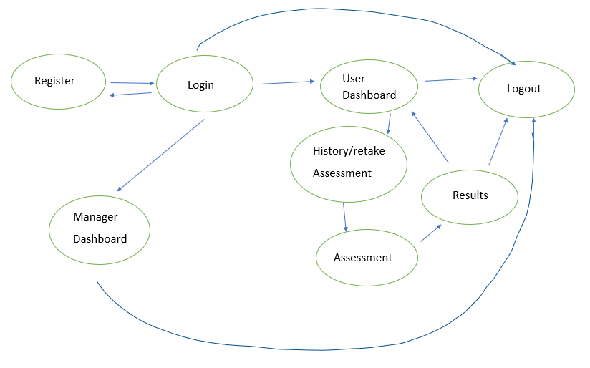
Solution

Slide 7





Tools
Postgres database
Java
Angular 2+
GitHub
Google Hangout
Google Drive
Jetty
Captcha

Slide 8

Schedule
Week 2-5 : Preparation of the project
Environments (Angular)
Tutorials
UI designs
Database
Week 6-7:Connections
Connections with the database
Server connections
Week 8: Designing the pages
Creating the pages and routing them
Notes:
An efficient way to solve the problem

Slide 9
Schedule (cont.)
Week 9-11:Design Pages
Creating the base design
Experimented with Java
Week 12-14:Connectivity
Connecting everything together
Issues and met with Royce
Brushing up pages
Week 16:Final Touches
Design improvements
Testing
Captcha

Slide 10
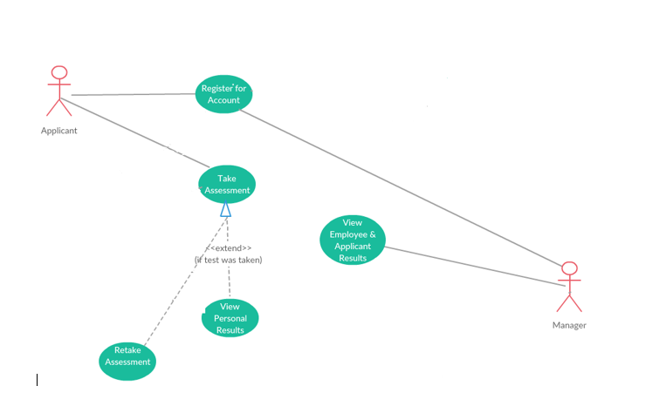
USE CASE DIAGRAM

Slide 11
User-Points
1 | Register on site | 3
2 | View previous assessment results | 3
3 | Take 10 key assessment (Four Types) | 8
4 | Captcha | 6
5 | View statistics about all assessments | 5
6 | View results of other users (Manager) | 5
7 | Authenticate User | 6
8 | Define user roles | 2
9 | See results after assessment | 2
10 | Set up database | 3
11 | Set up development environments | 3
12 | Sketch UI design | 4
13 | Hook up project (FE, BE, DB, GitHub) | 6

Slide 12
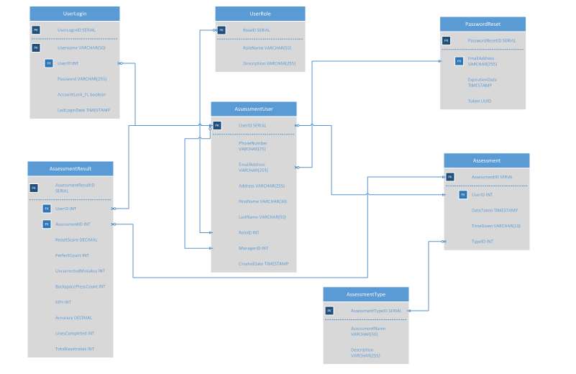

Slide 13

Progress
Created a front-end and a back-end environment
UI designs
Designed all pages
Java-NodeJS-Java
Implementing new elements
Database connectivity
Documentation
Verification and Authentication
Captcha

Slide 14

Risks Issues
Cheating
Goals per sprint
Framework
Resources for environments
Server
Designing pages
Java vs NodeJS
Limit the pages we can do
Database flow
Standard for coding
Environment – Completed
Framework—there is a steep learning curve
Design issues
Redefining roles
Server connection and backend
Java vs NodeJS
Timer
Running into time constraints
Database flow
Notes:
Come back

Slide 15

DEMO

Slide 16

Reflection
Learning experience
Angular
Setup
Database design – Postgres
Designing the pages
Connections
Setbacks
Java
IntelliJ
Connections
Team Bonding
GitHub

Slide 17

Questions

